Slide 1




ANNA UNIVERSITY
MADRAS INSTITUTE OF TECHNOLOGY CAMPUS
CHENNAI – 600 044
Creative Inovative Project - Review 2
Sub Code: CS6611
Secure Image Key Generation for Medical image security using Wasserstein Generative Adversarial Network with Gradient Penalty
Presented by
Guided by
Malarvannan M (2022503011)
Dr.R.Kathiroli
Assistant Professor
Dept of Computer Technology
Anna University, MIT campus
Maanasa Prathap Chander (2022503065)
Kalaidharun R (2022503009)
1

Slide 2

OutLine
01
Problem Statement
07
Algorithm
02
Abstract
08
Metrics
03
Objectives
09
Test case
04
Literature Survey
10
Implementation plan
05
Architecture Diagram
11
Tools and libraries
06
Module wise Architecture Diagram
2

Slide 3
OutLine
13
Training Environment
14
Implementation
15
Metrics obtained
16
Analysis
17
Quick Demo
18
Output
19
References
3

Slide 4
Problem Statment
Traditional cryptographic key generation depends on deterministic algorithms which can be suspectible to attacks if the entropy is very less.
Machine Learning based key generation approaches are currently booming to generate high entropy keys but they suffer from training instability and mode collapse.
This highlights the need for the use of a more stable model for the training process to overcome training instability, mode collapse and to generate a strong quality key.
4

Slide 5
Abstract
The need for medical image encryption is increasingly pronounced to safeguard the privacy of the patient’s medical imaging data.
Generative Adversial Network (GAN) have shown promising result in generating a strong high entropy key and encypting the medical image.
However, they suffer from training instability and mode collapse reducing the effectiveness of generated key.
Thus we have come with Wasserstien GAN - Gradient Penality to overcome this issue by enforcing Lipshitz continuity for better genralization
5

Slide 6
Objective
To develop a secure one-time pad key generation cryptographic system using WGAN-GP and evaluate the quality of it.
To enhance training stability.
To provide a more secured cryptosystem.
6

Slide 7
Literature Survey
S.NO | Title | Name of the Journal and Published Year | Proposed Methodology | Limitations
1 | DeepKeyGen: A Deep Learning-Based Stream Cipher Generator for Medical Image Encryption and Decryption | IEEE Transactions on Neural Networks and Learning Systems / 2022 | DeepKeyGen presented a deep learning-based stream cipher generator that utilized Generative Adversarial Networks (GANs) for the encryption and decryption of medical images. | The process relies heavily on the randomness of deep learning models, which can cause inconsistencies in key generation even under identical conditions and the training process is unstable.
2 | DeepEDN: A Deep-Learning-Based Image Encryption and Decryption Network for Internet of Medical Things | IEEE Internet of Things Journal / 2021 | DeepEDN is an end-to-end encryption-decryption framework for IoMT. It uses Cycle-GANs to encrypt medical images and an inverse mapping network for loss-minimized decryption. An ROI mining network enables selective retrieval of critical data without full decryption. | The computational complexity is very high as Cycle-GANs and ROI mining require significant processing power
7

Slide 8
Literature Survey
S.NO | Title | Name of the Journal and Published Year | Proposed Methodology | Limitations
3 | DeepENC: Deep Learning-Based ROI Selection for Encryption of Medical Images Through Key Generation with Multimodal Information Fusion | IEEE Transactions /2024 | DeepENC securely encrypts the Region of Interest (ROI) in medical images using a 2D hybrid chaotic key. It leverages UNet3+ for ROI segmentation and biometric features for key generation, ensuring high security with low computational cost. | There are some potential vulnerabilities in this such as, while selective ROI encryption improves efficiency, the unencrypted background could still leak contextual information about the medical image.
8

Slide 9
Literature Survey
S.NO | Title | Name of the Journal and Published Year | Proposed Methodology | Limitations
4 | Chaotic Medical Image Encryption Method Using Attention Mechanism Fused with ResNet Model | Frontiers in Neuroscience / 2023 | AT-ResNet-CM enhances medical image encryption by integrating an attention mechanism with ResNet for high-dimensional feature extraction. The attention module focuses on critical regions, improving encryption quality, while a chaotic system ensures randomness and security. | It requires careful tuning of its attention mechanism and chaotic system. If not configured properly, the encryption quality may drop, potentially affecting security and performance.
9

Slide 10
Literature Survey
S.NO | Title | Name of the Journal and Published Year | Proposed Methodology | Limitations
5 | Deep Learning-Based Encryption Scheme for Medical Images Using Deep Convolutional Generative Adversarial Networks | Nature Scientific Reports / 2024 | Utilizes Deep Convolutional Generative Adversarial Networks (DCGANs) for encrypting medical images. Implements Virtual Adversarial Training (VAT) to enhance robustness against adversarial attacks. | Mode collapse is a well-known issue in DCGANs where instead of exploring the full distribution of possible transformations, the model starts producing similar outputs for different inputs. This happens because the generator finds a "shortcut" to fool the discriminator without learning a complete mapping from the original image space to the encrypted space.
10

Slide 11
Literature Survey
S.NO | Title | Name of the Journal and Published Year | Proposed Methodology | Limitations
6 | EiMOL: A Secure Medical Image Encryption Algorithm based on Optimization and the Lorenz System | ACM Transaction / 2023 | EiMOL uses the Lorenz chaotic system combined with optimization techniques to generate a random sequence, transforming medical images into encrypted data. | EiMOL uses a chaotic system (Lorenz), which could be reverse-engineered by attackers to break the encryption.
7 | A Faster Privacy-Preserving Medical Image Diagnosis Scheme with Machine Learning | Springer / 2024 | Uses CKKS Homomorphic Encryption for encrypting both medical images and diagnostic parameters. | Homomorphic encryption is computationally expensive and requires high processing power.
11

Slide 12
Literature Survey
S.NO | Title | Name of the Journal and Published Year | Proposed Methodology | Limitations
8 | MedBlindTuner: Towards Privacy-preserving Fine-tuning on Biomedical Images with Transformers and Fully Homomorphic Encryption | Springer/ 2024 | Encrypts medical images before training, allowing ML models to learn without decrypting sensitive data and utilizes DEiT (Data-Efficient Image Transformer) for efficient image classification. | FHE operates on encrypted data using techniques like ciphertext addition and multiplication, which are computationally expensive and not natively supported by GPUs/TPUs.
12

Slide 13
Literature Survey
S.NO | Title | Name of the Journal and Published Year | Proposed Methodology | Limitations
9 | CaRENets: Compact and Resource-Efficient CNN for Homomorphic Inference on Encrypted Medical Images | Springer / 2024 | CaRENets presents a significant advancement in performing CNN-based inference on encrypted medical images by introducing a compact and resource-efficient approach. | Despite the optimizations, homomorphic encryption inherently introduces substantial computational overhead and processing time is very high for high resolution image
10 | RISE: Rubik’s Cube and Image Segmentation-Based Secure Medical Image Encryption | Springer / 2024 | The medical image is divided into multiple segments for enhanced security. Each segment undergoes a scrambling process based on the Rubik’s Cube principle to create randomness. | The security of the encryption heavily depends on the initial key and transformation steps, making it vulnerable to brute-force or differential attack
13

Slide 14
Literature Survey
S.NO | Title | Name of the Journal and Published Year | Proposed Methodology | Limitations
11 | Quantum image encryption protocol for secure communication in healthcare networks | Springer / 2025 | The one-dimensional discrete chaotic map, termed the logistic-sin map is used to generate key and the plain image is split into 2 images and they are converted into gray code and then encrypted | The final Cipher image is less unpredictable and non-deterministic when compared to WGAN-GP It has low Scalablity of applications
12 | Medical Image Encryption Based on Josephus Scrambling and Dynamic Cross-Diffusion for Patient Privacy Security | IEEE Transactions / 2024 | Hyperchaotic system for key generation, Josephus scrambling for pixel position permutation, and dynamic cross-diffusion for pixel value confusion. The encryption key is dynamically updated using the SHA-256 hash of the image, ensuring unique encryption for each image. | Josephus-based encryption relies on a chaotic system, which is deterministic for the same initial conditions. WGAN-GP learns to generate diverse keys dynamically, making it harder to predict key patterns.
14

Slide 15
Literature Survey
S.NO | Title | Name of the Journal and Published Year | Proposed Methodology | Limitations
13 | Reversible Data Hiding in Encrypted Images With Secret Sharing and Hybrid Coding | IEEE Transactiosn on Circuits and Systems for Video Technology / 2023 | This proposes a method to hide secret data such as text messages, image or binary data into an image and encrypt it securely while ensuring the image can be fully restored back Uses a combined technique of secret sharing( splitting data into multiple parts) and hybrid coding( to increase the amount of data that can be hidden) | Usage of secret sharing (CRTSS) and hybrid coding requires significant computational power making it less-efficient for real time applications Extra storage and bandwidth requirement for storing and sharing multiple shares of the image
14 | An algorithm for secure medical image transmission that utilizes Arnold’s Cat MaP and encode-decode | Proceedings of the 2024 IEEE Wireless Power Technology Conference and Expo (WPTCE2024) / 2024 | Uses a Physics-Informed Neural Network (PINN) to estimate mutual inductance in SS-IPT systems by integrating physics-based equations with neural network learning, leveraging transmitter-side voltage and current data. | The method is validated only through simulations, lacking real-world experimental verification, which may affect accuracy due to noise and hardware tolerances.
15

Slide 16
Literature Survey
S.NO | Title | Name of the Journal and Published Year | Proposed Methodology | Limitations
15 | Efficient Security and Authentication for Edge-Based Internet of Medical Things | IEEE Internt of Things Journal/ 2021 | This approach utilizes Left Data Mapping (LDM), Pixel Repetition Method (PRM), RC4 encryption, and checksum computation to ensure data integrity and confidentiality. | RC4 encryption is weak compared to modern cryptographic standards. Tamper detection may be less effective under extreme noise or compression. Scalability issues for real-time, large-scale IoMT applications.
16

Slide 17
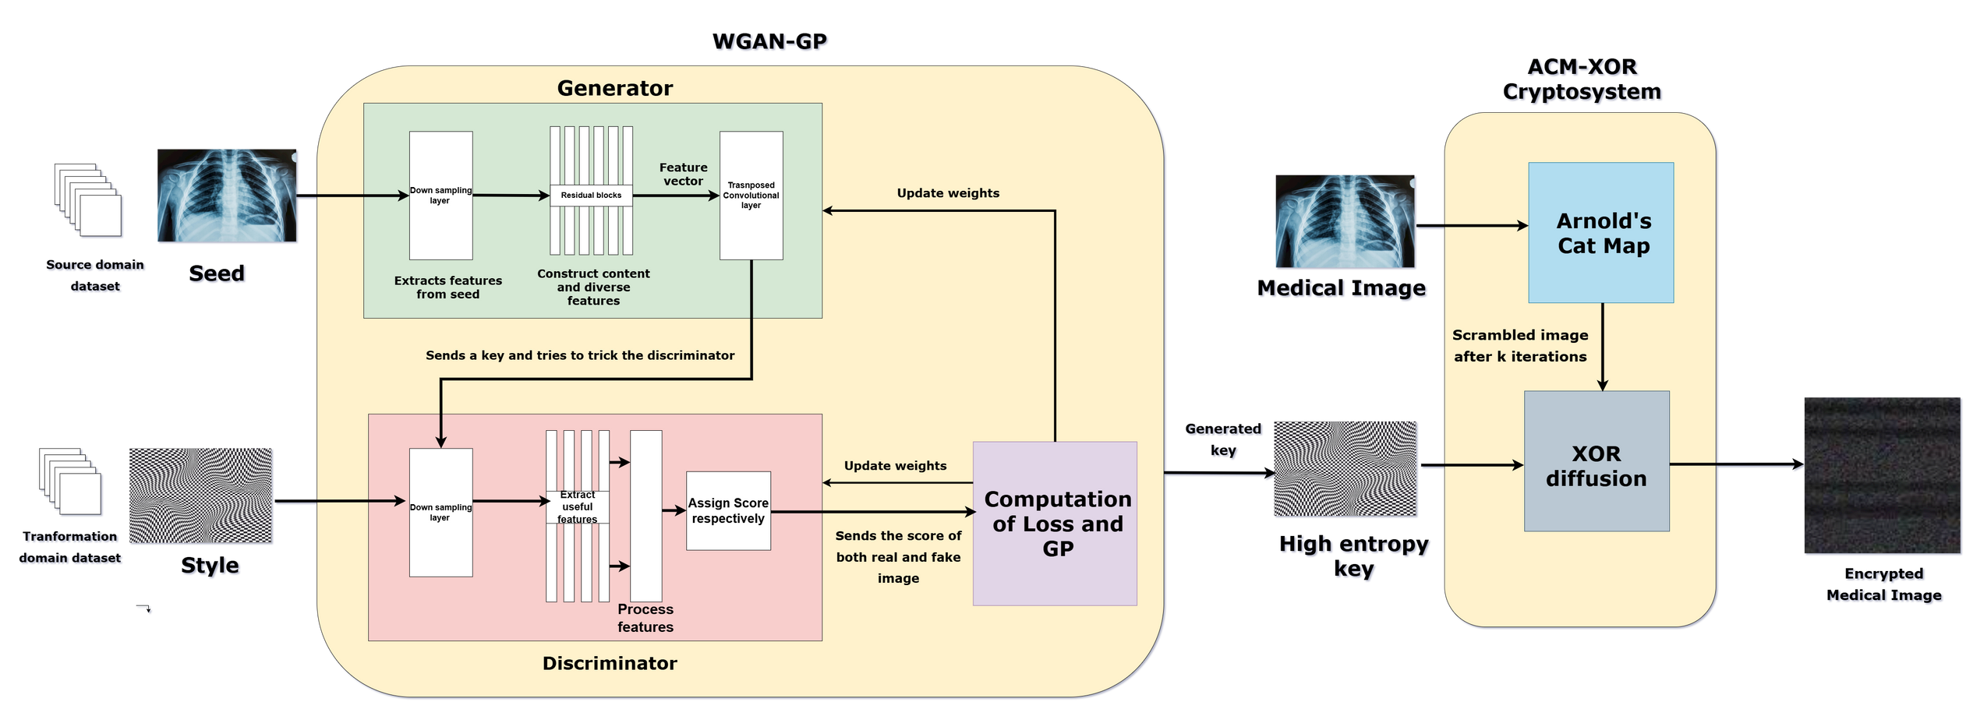
Architecture Diagram
Fig 1. How the proposed model works
[ Created using Draw.io ]
17

Slide 18
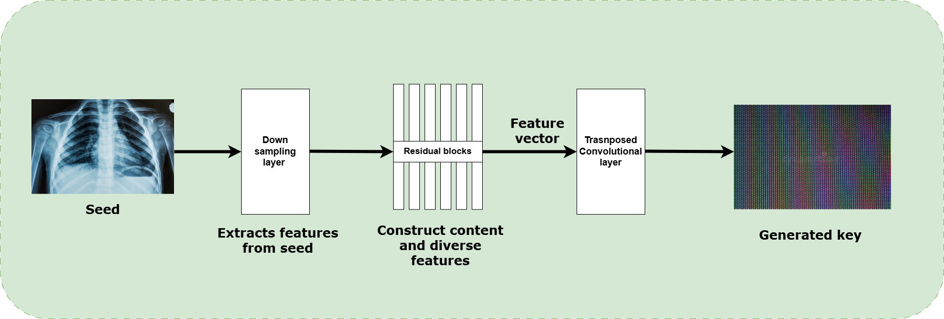
Architecture Diagram
Generator
Fig 1.2. How the generator generates a key
[ Created using Draw.io ]
18

Slide 19
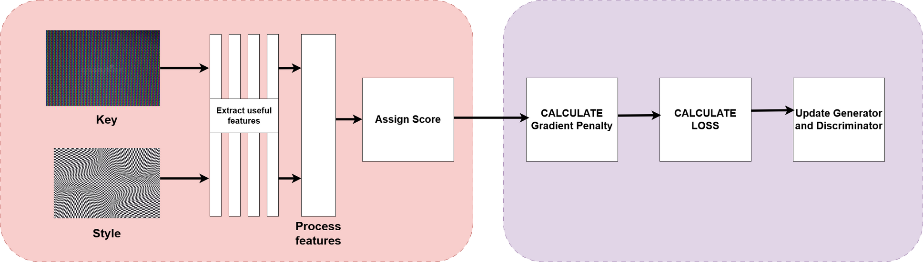
Architecture Diagram
Discriminator
GP and loss updation
Fig 1.3. How the discriminator assigns score for the key and how the gradient penalty is calculated
[ Created using Draw.io ]
19

Slide 20
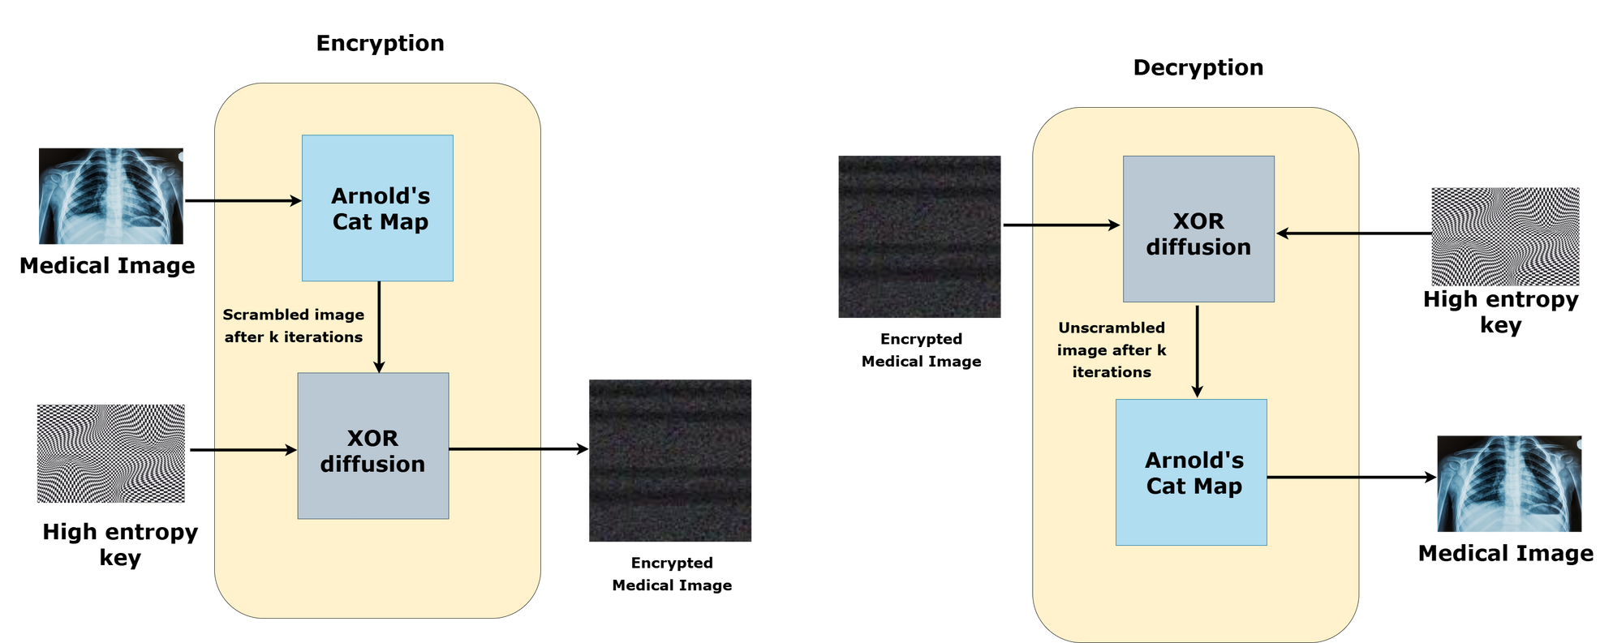
Architecture Diagram
Cryptosystem
Fig 1.4. How ACM and XOR diffusion is used to encrypt and decrypt the medical image using the high entropy key obtained by WGAN-GP
[ Created using Draw.io ]
20

Slide 21
Modules
Key Generation :
Here the strong high entropy key is generated using WGAN-GP
The WGAN-GP consists of Generator, Discriminator and uses Gradient penalty and the loss is calculated and propagated.
This fight will continue till the model stabilizes and finally generates a strong key.
Input: Seed image and Style image
Expected output: High Entropy Key
Encryption -: 2-layer security (confusion + diffusion)
Arnold’s Cat Map(ACM) - To scramble pixel positions within an image to create a visually distorted version using predefined set of parameters
Perform XOR operation between the scrambled image and the WGAN-GP generated key.
21

Slide 22

Algorithm for Key generation Module : WGAN-GP
Initialization: Randomly initialize the parameters W of the DeepKeyGen, Wn = random [Wn,1,Wn,2, ... ,Wn,i]. Define the dimension of KEY as 256 x 256 x 3.
Output: High entropy key
while Epoch < Epoch_target do
x = Convert(IMAGE_sourcedomain);
y = Convert(IMAGE_transformationdomain) // Convert training images into 256 x 256 x 3 matrices.
KEY = G(x) // Forward propagation of generator network G. At the last layer of G, the KEY is generated.
Result = D(y) // Forward propagation of discriminator network D. Output the judgment result whether the input is from transformation domain.
L = LG + LD / / Calculate the total loss L.
Backward(L) // Backward propagation.
Wj= Wj-1 - A J(W) // Calculate the gradient that pass back to each layer, and then update the network parameters.
end while
22

Slide 23
Algorithm for ACM+XOR Cryptosystem
Encryption :
Input : Medical Image, key
scrambled_image = ACM(medical_image,k_iterations) // This shuffles the pixel positions of the image up to k iterations
encrypted_image = XOR(scrambled_image, key)
Output : ciphered medical image
Decryption :
Input : Encrypted medical Image, key
unscrambled_image = Reverse_ACM(encrypted_medical_image,k_iterations) // This unshuffles the pixel positions of the image which was shuffled by the scrambler previously
plain_image = XOR(unscrambled_image, key)
Output : deciphered medical image
23

Slide 24
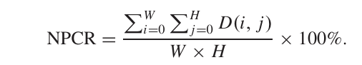
Metrics
a) NPCR (Sensitivity)
NPCR denotes the pixel change rate, which is used to indicate the ratio of different pixel values at the same location of two images.
where,
W , H -> Width and Height of the image
D(i, j) -> Pixel Change Indicator Function , where i and j are pixel positions.
D(i,j) is 1 if both pixels are same else it is 0 .
24

Slide 25
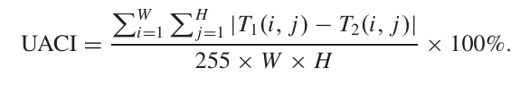
Metrics
b) UACI (Sensitivity)
Measures how much the pixel values change in intensity.Ensures that the differences between the two private keys are not just binary changes but are also spread over a wide range of values.
where,
T1(i,j) and T2(i,j) are the pixel values at position (i, j) in the two generated private keys
25

Slide 26
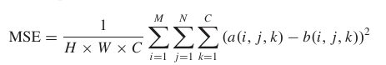
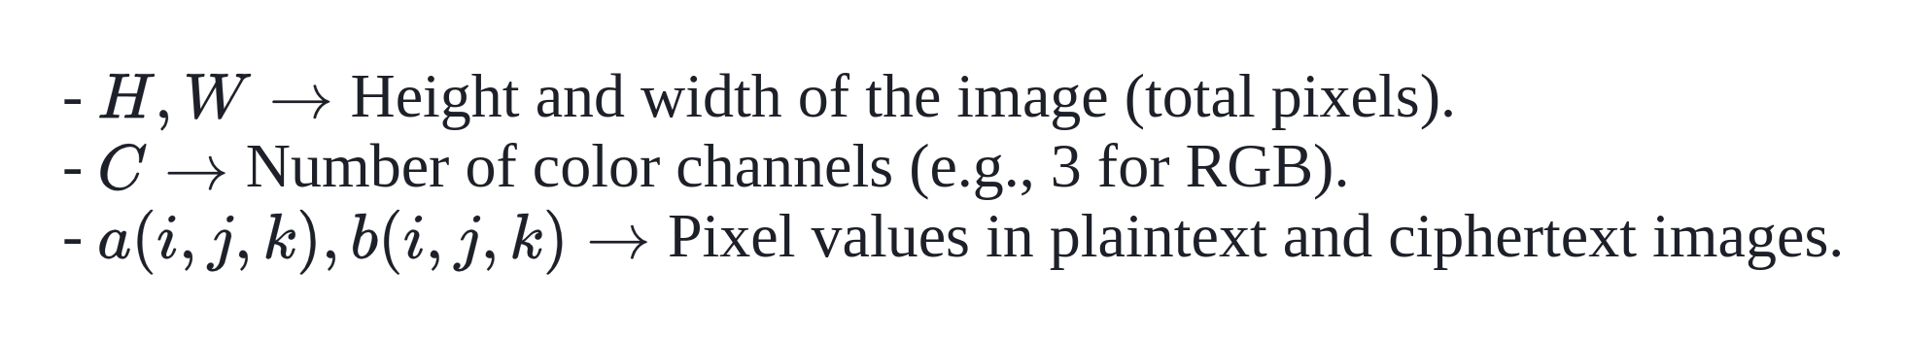
Metrics
C) Mean Square Error (MSE)
Used to measure the average squared difference between corresponding pixel values of two images. It evaluates how much the encrypted image (ciphertext) deviates from the original image (plaintext)
where,
26

Slide 27
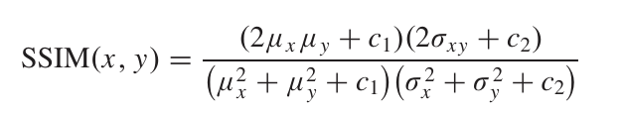
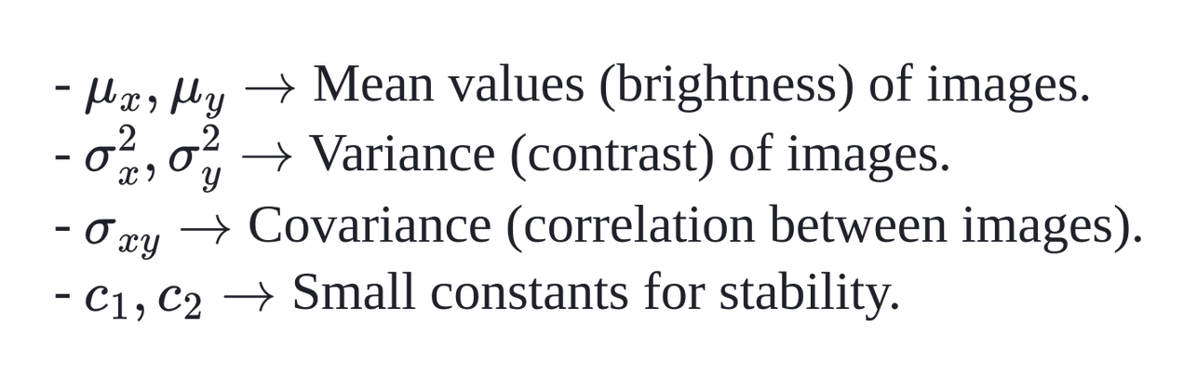
Metrics
D) Structural Similarity Index (SSIM)
Metric that measures the similarity between two images by considering structural information, luminance, and contrast. Used for evaluating structural similarity.
where,
27

Slide 28
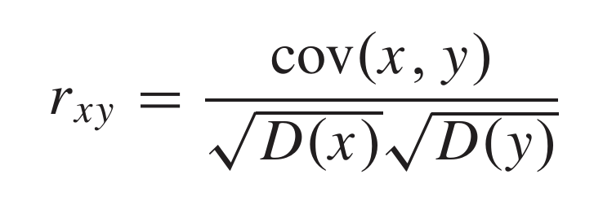
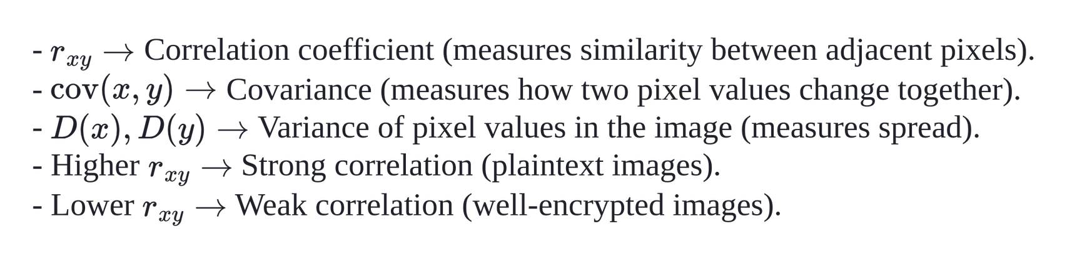
Metrics
E) Correlation Analysis
Correlation analysis measures the relationship between adjacent pixels in an image. A strong correlation in plaintext images makes them vulnerable to attacks, so encryption aims to reduce this correlation in ciphertext images for higher security.
where,
28

Slide 29
Test cases
TC1: Ascertain that a high entropy key is conjured.
TC2: Can the encrypted image be restored with the same clarity?
TC3: Is the key forged uniquely with each invocation?
29

Slide 30
Implementation plan
Phase 1 : Implement the WGAN-GP module.
Phase 2 : Test the quality of the key generated from WGAN-GP module
Phase 3 : Implement ACM + XOR diffusion for image encryption.
Phase 4 : Test the quality of the encrypted image
30

Slide 31
Tools and libraries
PyTorch : A machine learning library that includes algorithms like neural networks, support vector machines,
TorchVision : It is a package within Torch that provides image and video processing capabilities
SciPy and Numpy : For mathematical computations and optimizations
Medical Image Dataset :
https://www.kaggle.com/datasets/raddar/tuberculosis-chest-xrays-montgomery
https://www.kaggle.com/masoudnickparvar/brain-tumor-mri-dataset
Transformation domain Dataset:
https://www.kaggle.com/datasets/vishalbakshi/hms-hbac-training-spectrogram-images
31

Slide 32
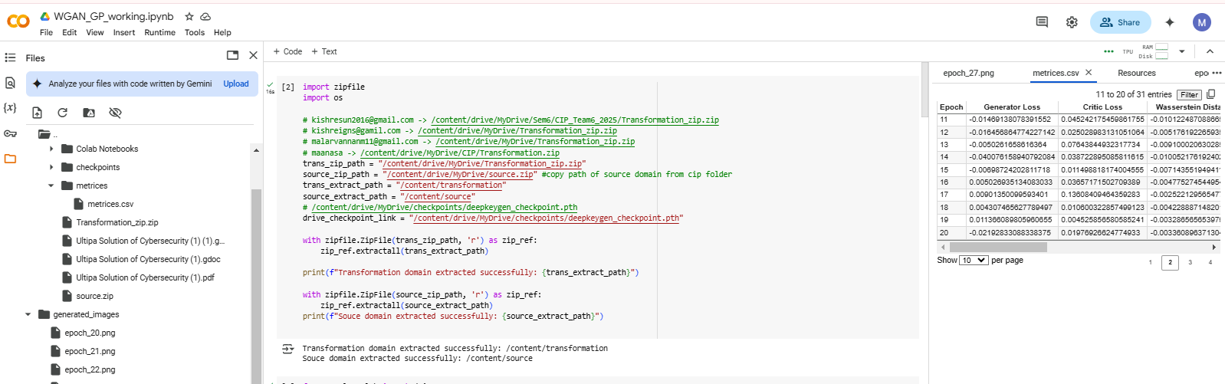
Training Environment
Our WGAN-GP model is trained/being trained in google colab using TPU ( Tensor Processing Unit )
Fig 2. Google colab Environment
32

Slide 33
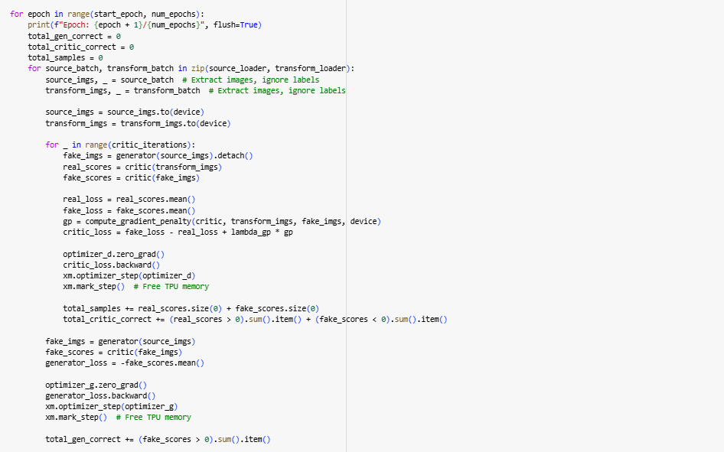
Implementation
train_DeepKeyGen() : Training the model
Fig 3. Process in each epoch of the training
33

Slide 34
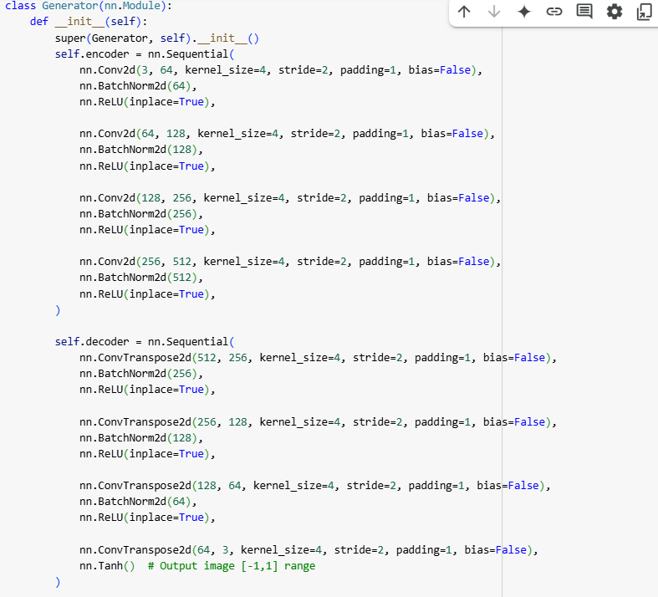
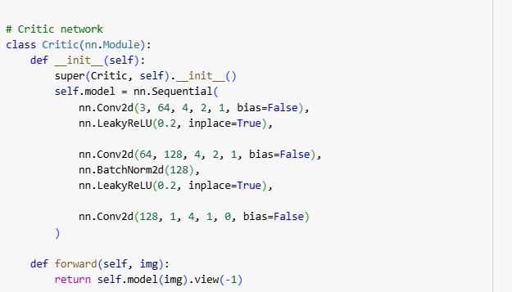
Implementation
Generator() : Creates fake image from real image
Critic() : Evaluates the authenticity of real and fake images
Fig 4. Generator code
Fig 5. Critic code
34

Slide 35
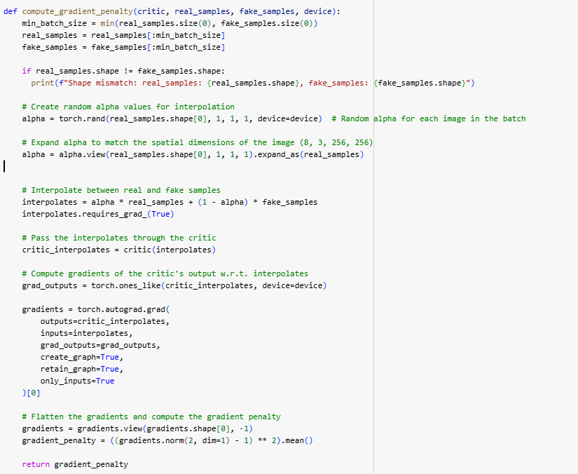
Implementation
compute_gradient_penalty() : ensures the critic's gradient norms stay close to 1 for stable training
Fig 6. Gradient Penalty code
35

Slide 36
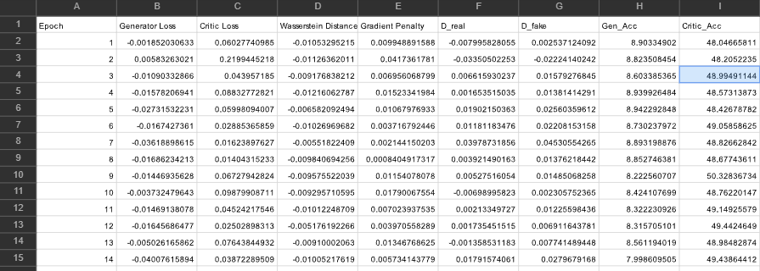
Metrics Obtained
The Metrics such as generator loss, critic loss, wasserstein distance, gp obtained at each each epoch was stored in a csv file
Fig 7. Metrics obtained at each epoch
36

Slide 37
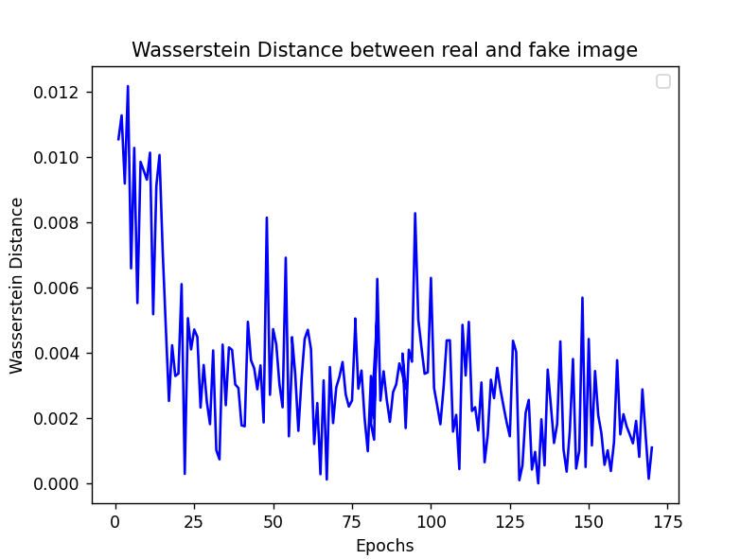
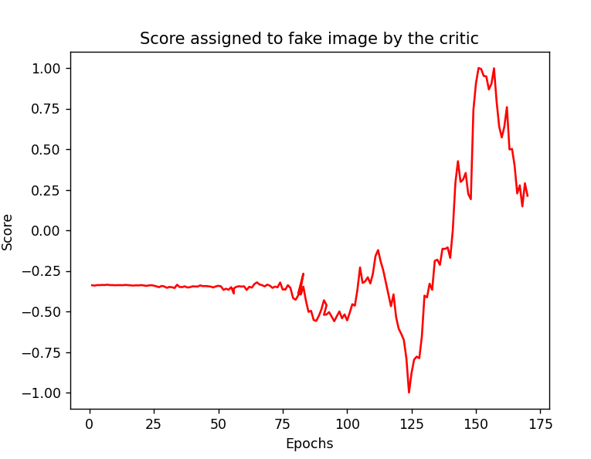
Analysis
Wasserstein Distance Analysis
Score Analysis
Fig 7.1 Wasserstein distance between the generated fake image and the real image
Fig 7.2 Score assigned to fake image by critic
37
[ Graphs plotted using Matplotlib ]

Slide 38
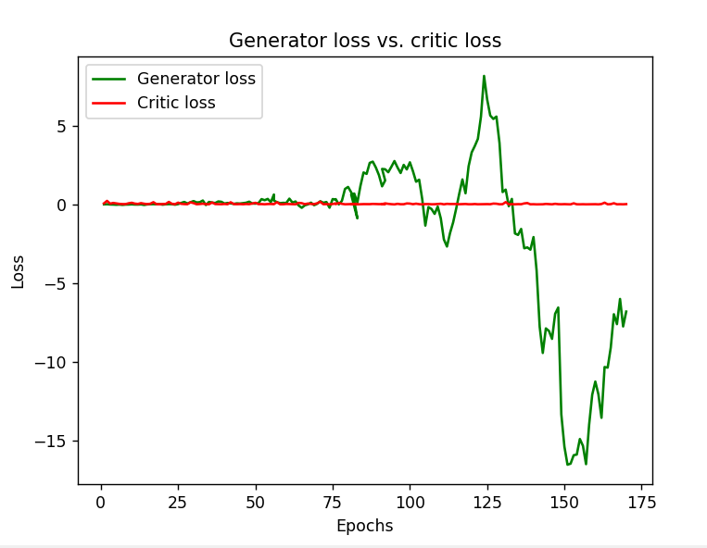
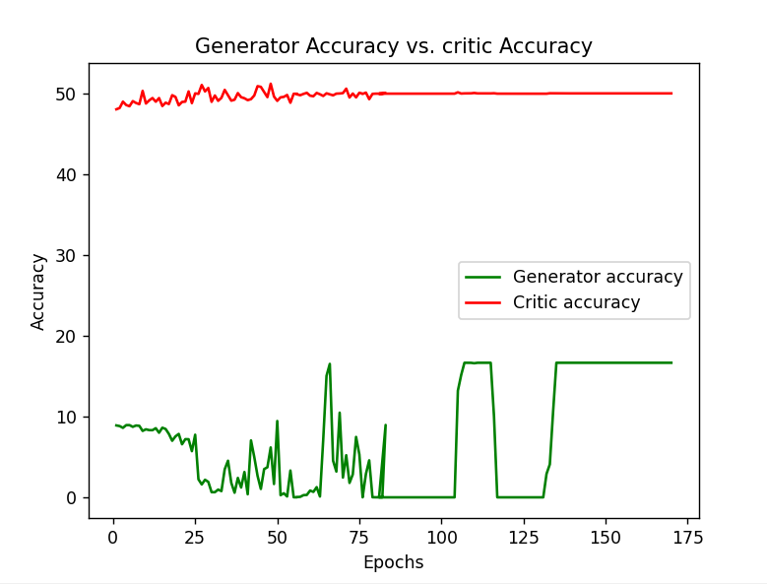
Analysis
Loss Analysis
Accuracy Analysis
Fig 7.3. Loss assigned to Generator and Critic
Fig 7.4 Accuracy of the Genearator and Critic at each epoch
38
[ Graphs plotted using Matplotlib ]

Slide 39
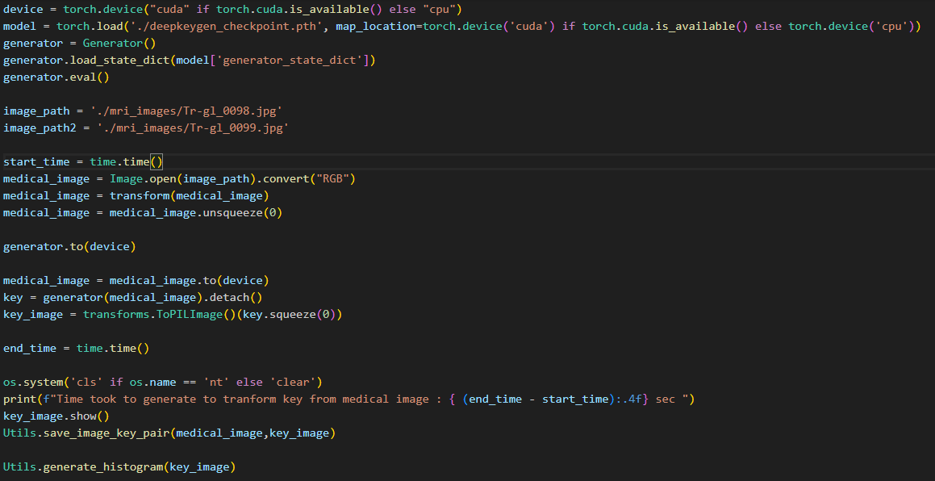
Quick Demo
Code to get a key (image) by giving a medical image as input
Fig 8. Implementaion of code which deals with the key generation with medical image as input
39

Slide 40
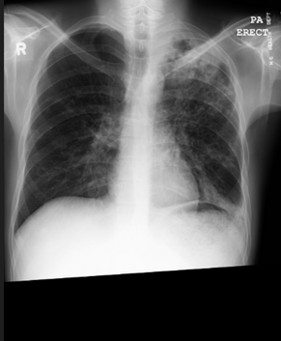
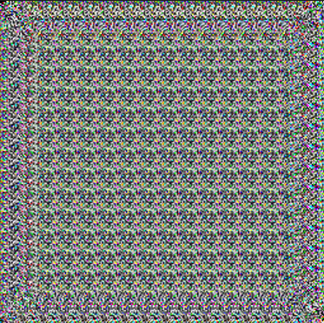
Output
Fig 9.1. Input image and generated key
Fig 9.2. Time taken to generate the key
40

Slide 41
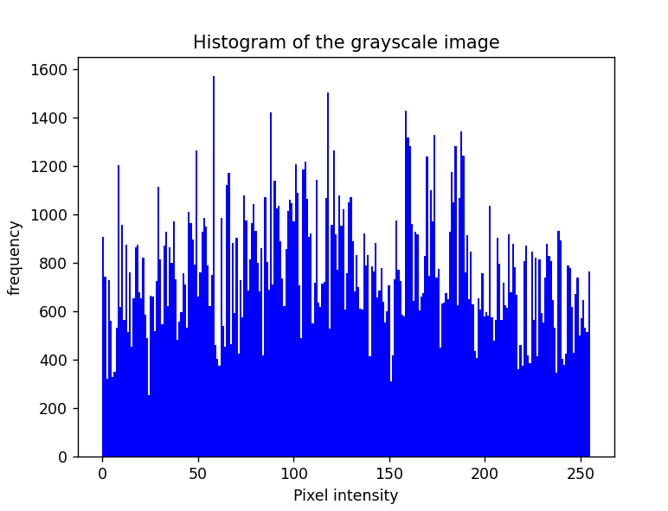
Output
Frequency of the each gray scale value (0-255) in the key
Fig 9.3. Gray Scale Histogram Analysis
[ Graphs plotted using Matplotlib ]
41

Slide 42
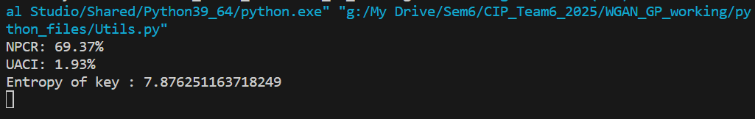
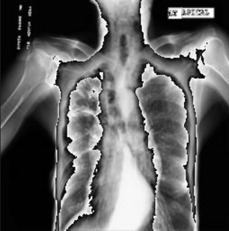
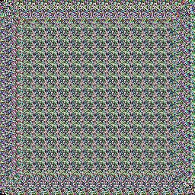
Output
Number of Pixel Rate and Unified Averaged Changed Intensity between the 2 generated private keys and Entropy
Fig 10.2. Number of Pixel Change Rate, Unified Averaged Changed Intensity between two generated private keys and Entropy of the key1
Fig 10.1. Image-Key pair generated using two differnt Iamges
42

Slide 43
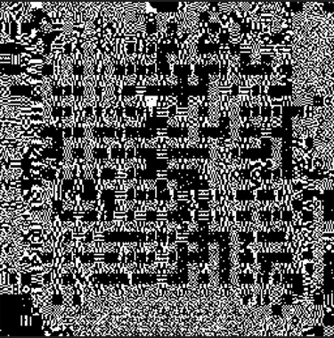
Output
Difference between two generated private key
Fig 11.1. Generated private key 1
Fig 11.2. Generated private key 2
Fig 11.3. Difference between two keys
Fig 11. Visually represented difference between the two generated private keys
43

Slide 44
References
[1] P. Tang, X. Wang, B. Shi, X. Bai, W. Liu, and Z. Tu, “Deep FisherNet for imageclassification,” IEEE Trans. Neural Netw. Learn. Syst., vol. 30, no. 7, pp. 2244–2250, Jul. 2019.
[2] G. Li and Y. Yu, “Contrast-oriented deep neural networks for salient object detection,” IEEE Trans. Neural Netw. Learn. Syst., vol. 29, no. 12, pp. 6038–6051, Dec. 2018.
[3] Y. Ding, C. Luo, C. Li, T. Lian, and Z. G. Qin, “High-order correlation detecting in features for diagnosis of Alzheimer’s disease and mild cog- nitive impairment,” Biomed. Signal Process. Control, vol. 53, Aug. 2019, Art. no. 101564.
[4] H. Chen, Z. Qin, Y. Ding, L. Tian, and Z. Qin, “Brain tumor seg- mentation with deep convolutional symmetric neural network,” Neuro- computing, vol. 392, pp. 305–313, Jun. 2020, doi: 10.1016/j.neucom. 2019.01.111.
[5] S. Jaeger, S. Candemir, S. Antani, Y. X. Wang, P. X. Lu, and G. Thoma, “Two public chest X-ray datasets for computer-aided screening of pulmonary diseases,” Quant. Imag. Med. Surg., vol. 4, p. 475, Dec. 2014. algorithm with NW algorithm for key generation,” J. Med. Syst., vol. 42, no. 1, p. 17, Jan. 2018.
44

Slide 45
References
[6] Ultrasound Nerve Segmentation. Accessed: Jan. 9. [Online]. Available: https://www.kaggle.com/c/ultrasound-nerve-segmentation/data/
[7] B. H. Menze et al., “The multimodal brain tumor image segmentation benchmark (BRATS),” IEEE Trans. Med. Imag., vol. 34, no. 10, pp. 1993–2024, Oct. 2015.
[8] S. Bakas et al., “Advancing the cancer genome atlas glioma MRI collections with expert segmentation labels and radiomic features,” Sci. Data, vol. 4, no. 1, Dec. 2017, Art. no. 170117.
[9] S. R. Moosavi, E. Nigussie, M. Levorato, S. Virtanen, and J. Isoaho, “Low-latency approach for secure ECG feature based cryptographic key generation,” IEEE Access, vol. 6, pp. 428–442, 2018.
[10] T. Liu, J. Tian, Y. Gui, Y. Liu, and P. Liu, “SEDEA: State estimation- based dynamic encryption and authentication in smart grid,” IEEE Access, vol. 5, pp. 15682–15693, 2017.
45

Slide 46
References
[11] S. Kalsi, H. Kaur, and V. Chang, “DNA cryptography and deep learning using genetic algorithm with NW algorithm for key generation,” J. Med. Syst., vol. 42, no. 1, p. 17, Jan. 2018.
[12] Y. Ding, C. Luo, C. Li, T. Lian, and Z. G. Qin, “High-order correlation detecting in features for diagnosis of Alzheimer’s disease and mild cog nitive impairment,” Biomed. Signal Process. Control, vol. 53, Aug. 2019, Art. no. 101564.
[13] H. Chen, Z. Qin, Y. Ding, L. Tian, and Z. Qin, “Brain tumor seg mentation with deep convolutional symmetric neural network,” Neuro computing, vol. 392, pp. 305–313, Jun. 2020, doi: 10.1016/j.neucom. 2019.01.111.
[14] S. Jaeger, S. Candemir, S. Antani, Y. X. Wang, P. X. Lu, and G. Thoma, “Two public chest X-ray datasets for computer-aided screening of pulmonary diseases,” Quant. Imag. Med. Surg., vol. 4, p. 475, Dec. 2014.
[15] Ultrasound Nerve Segmentation. Accessed: Jan. 9. [Online]. Available: https://www.kaggle.com/c/ultrasound-nerve-segmentation/data/
46

Slide 47
Thank
You
47

